Slide 1
ENEL 419 Probability and Random Variables
Introduction to Stochastic (Random) Processes
Dr. Abu Sesay

Slide 2
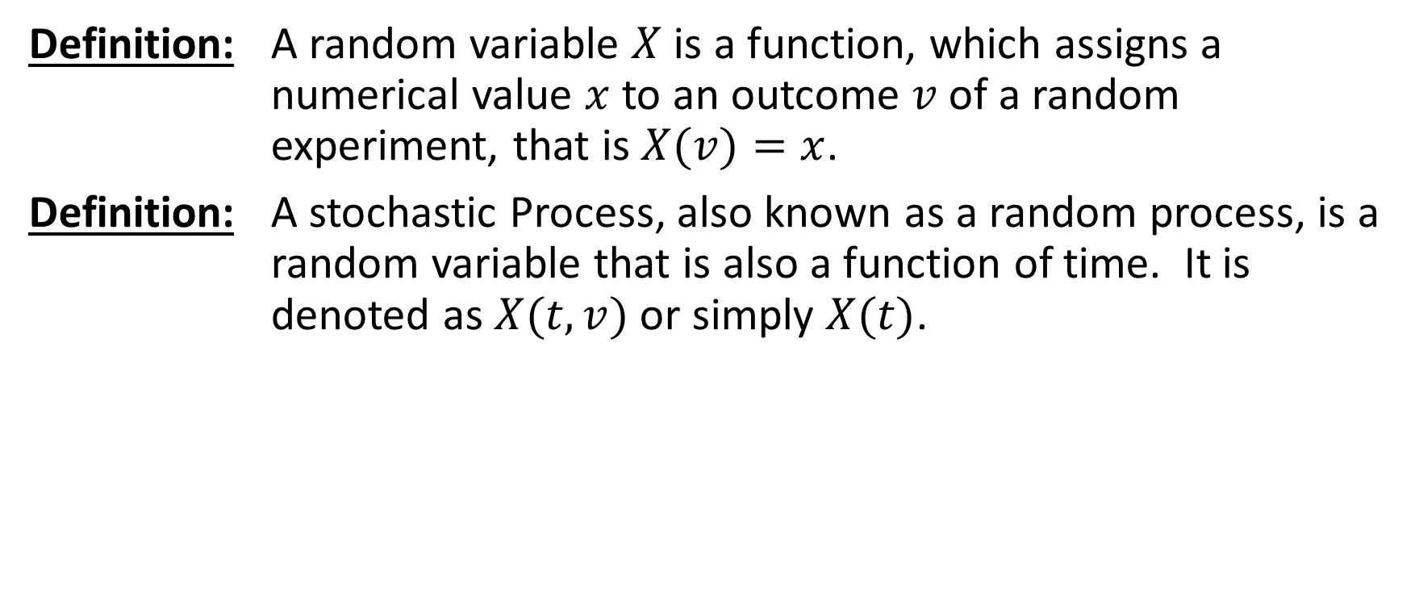
Random Variable versus Stochastic Process
Definition: A random variable $X$ is a function, which assigns a numerical value $x$ to an outcome $v$ of a random experiment, that is $X(v)=x$.
Definition: A stochastic Process, also known as a random process, is a random variable that is also a function of time. It is denoted as $X(t,v)$ or simply $X(t)$.

Slide 3
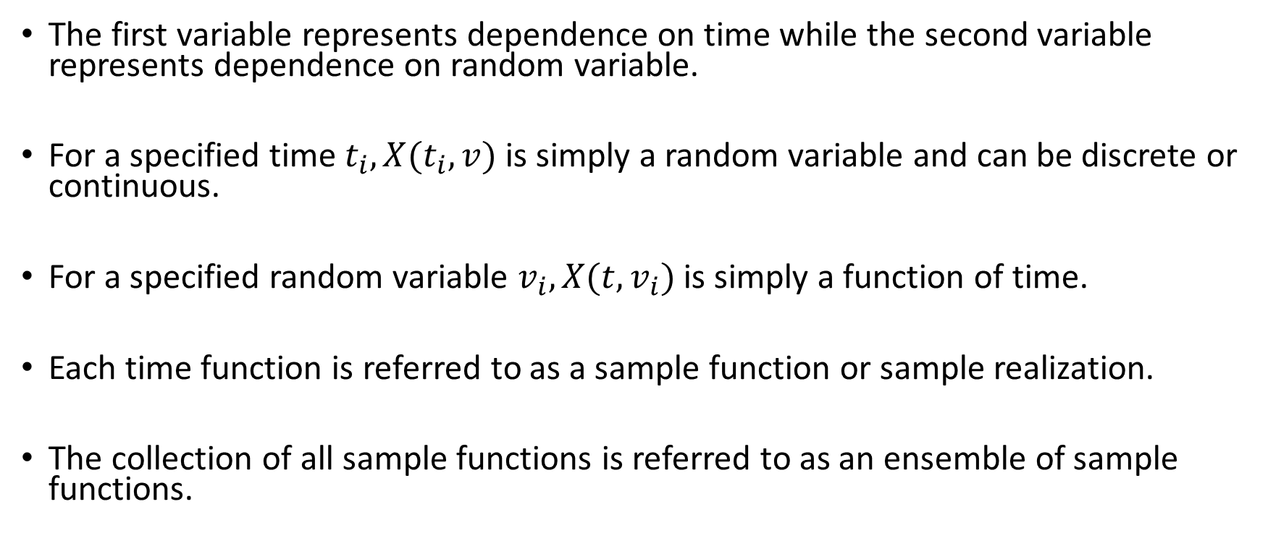
Stochastic (Random) Process
The first variable represents dependence on time while the second variable represents dependence on random variable.
For a specified time $t_{i}, X(t_{i},v)$is simply a random variable and can be discrete or continuous.
For a specified random variable $v_{i}, X(t,v_{i})$is simply a function of time.
Each time function is referred to as a sample function or sample realization.
The collection of all sample functions is referred to as an ensemble of sample functions.

Slide 4
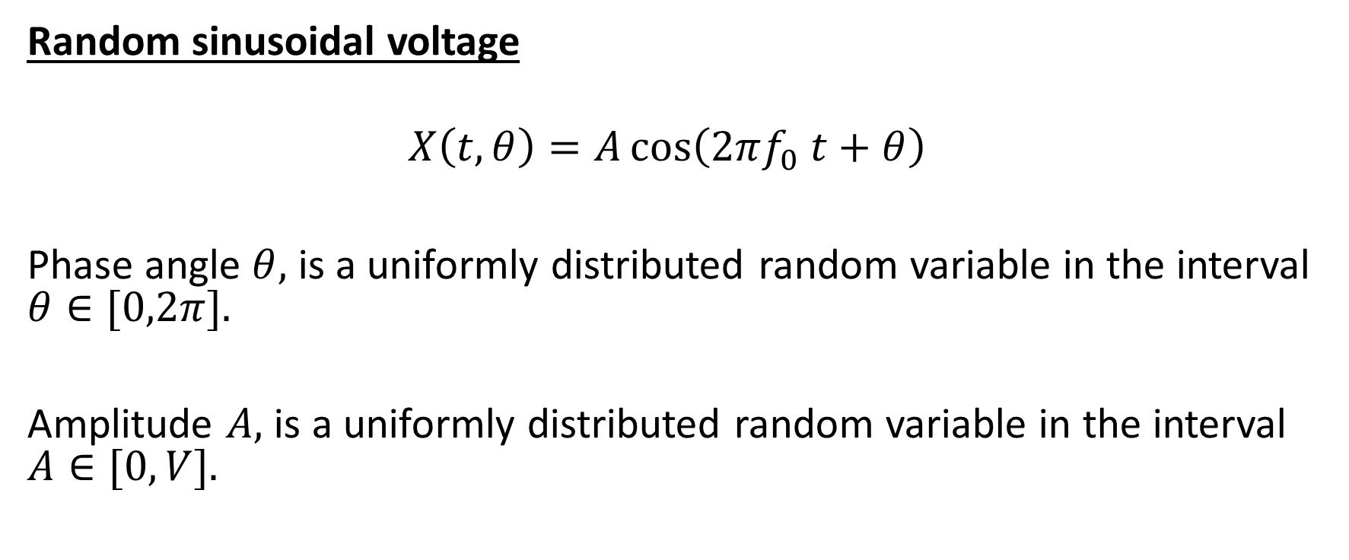
Examples of Stochastic Processes
Random sinusoidal voltage
$$X\left(t,θ\right)=A\cos\left(2πf_{0} t+θ\right)$$
Phase angle $θ,$ is a uniformly distributed random variable in the interval $θ∈[0,2π].$
Amplitude $A,$ is a uniformly distributed random variable in the interval $A∈[0,V].$

Slide 5
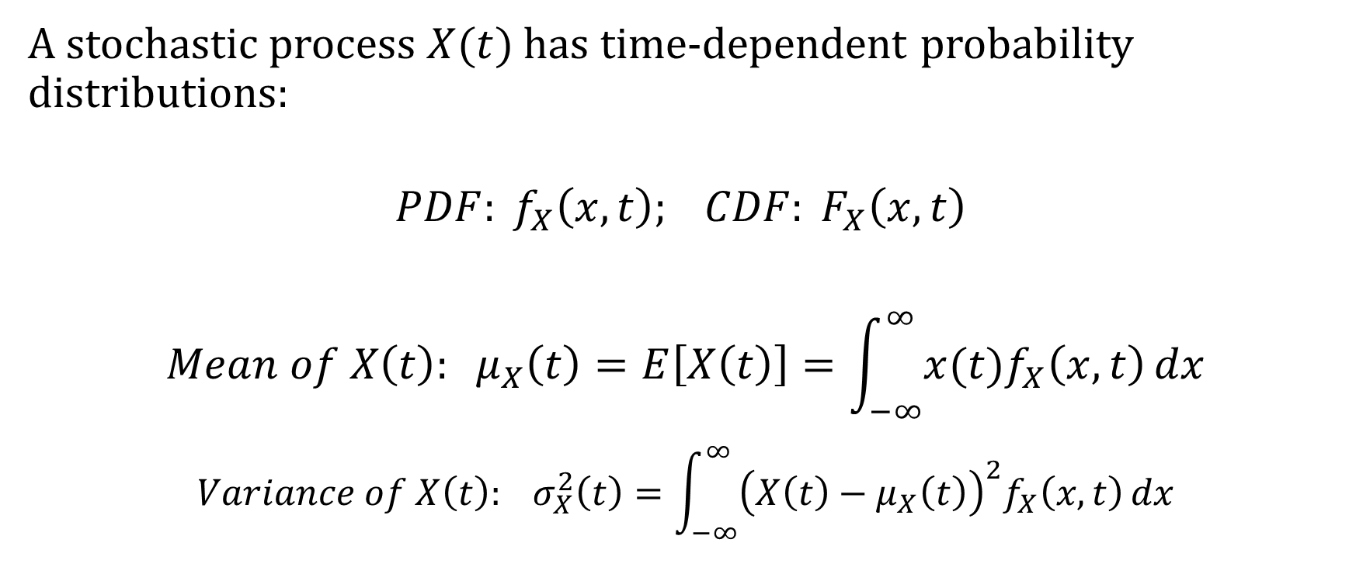
Statistical Descriptions of Random Processes
A stochastic process $X(t)$has time-dependent probability distributions:
$$PDF: f_{X}\left(x,t\right); CDF: F_{X}\left(x,t\right)$$
$${Mean of X\left(t\right): μ}_{X}\left(t\right)=E\left[X\left(t\right)\right]=\int_{−∞}^{∞}{x(t)f_{X}\left(x,t\right)}dx$$
$${Variance of X\left(t\right): σ}_{X}^{2}\left(t\right)=\int_{−∞}^{∞}{{\left(X\left(t\right)−μ_{X}\left(t\right)\right)}^{2}f_{X}\left(x,t\right)}dx$$

Slide 6
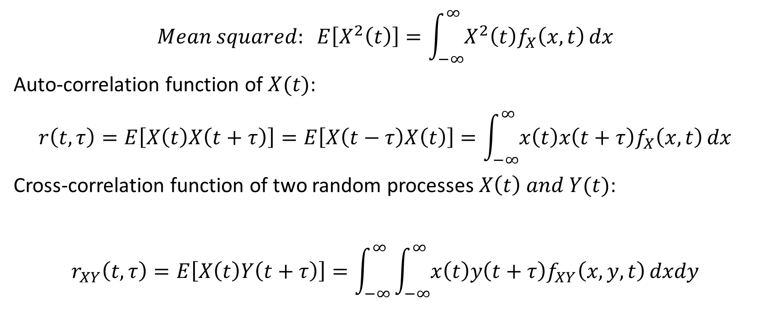
Statistical Descriptions of Random Processes
$$Mean squared: E\left[X^{2}\left(t\right)\right]=\int_{−∞}^{∞}{X^{2}\left(t\right)f_{X}\left(x,t\right)}dx$$
Auto-correlation function of $X(t)$:
$$r\left(t,τ\right)=E\left[X\left(t\right)X\left(t+τ\right)\right]=E\left[X\left(t−τ\right)X\left(t\right)\right]=\int_{−∞}^{∞}{x\left(t\right)x\left(t+τ\right)f_{X}\left(x,t\right)}dx$$
Cross-correlation function of two random processes $X\left(t\right) and Y(t)$:
$$r_{XY}\left(t,τ\right)=E\left[X\left(t\right)Y\left(t+τ\right)\right]=\int_{−∞}^{∞}{\int_{−∞}^{∞}{x\left(t\right)y\left(t+τ\right)f_{XY}\left(x,y,t\right)}dxdy}$$

Slide 7
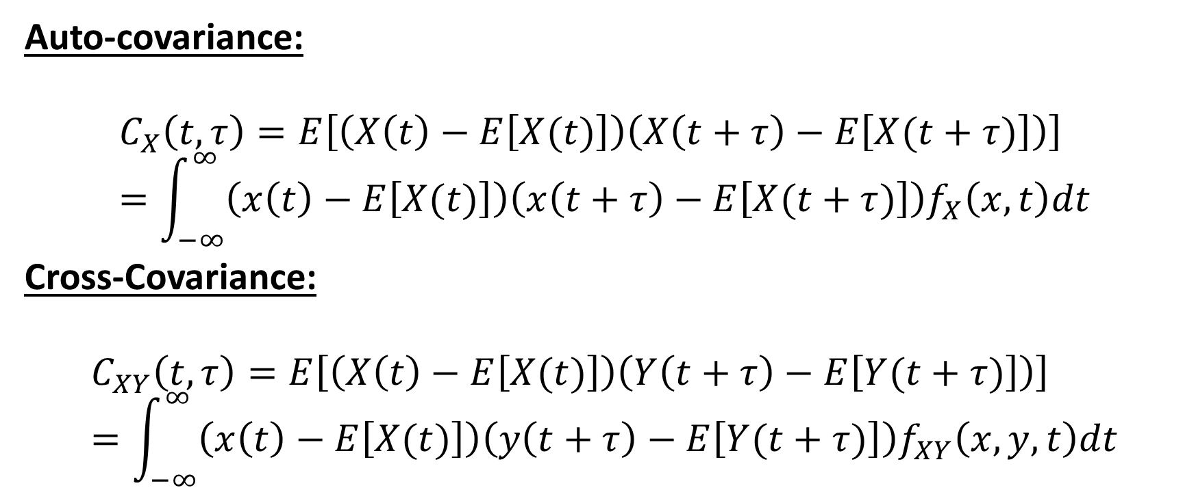
Auto-covariance and Cross-covariance
Auto-covariance:
$$C_{X}\left(t,τ\right)=E\left[\left(X\left(t\right)−E\left[X(t)\right]\right)\left(X\left(t+τ\right)−E\left[X(t+τ)\right]\right)\right]=\int_{−∞}^{∞}{\left(x\left(t\right)−E\left[X(t)\right]\right)\left(x\left(t+τ\right)−E\left[X(t+τ)\right]\right)f_{X}\left(x,t\right)dt}$$
Cross-Covariance:
$$C_{XY}\left(t,τ\right)=E\left[\left(X\left(t\right)−E\left[X(t)\right]\right)\left(Y\left(t+τ\right)−E\left[Y(t+τ)\right]\right)\right]=\int_{−∞}^{∞}{\left(x\left(t\right)−E\left[X(t)\right]\right)\left(y\left(t+τ\right)−E\left[Y(t+τ)\right]\right)f_{XY}\left(x,y,t\right)dt}$$

Slide 8
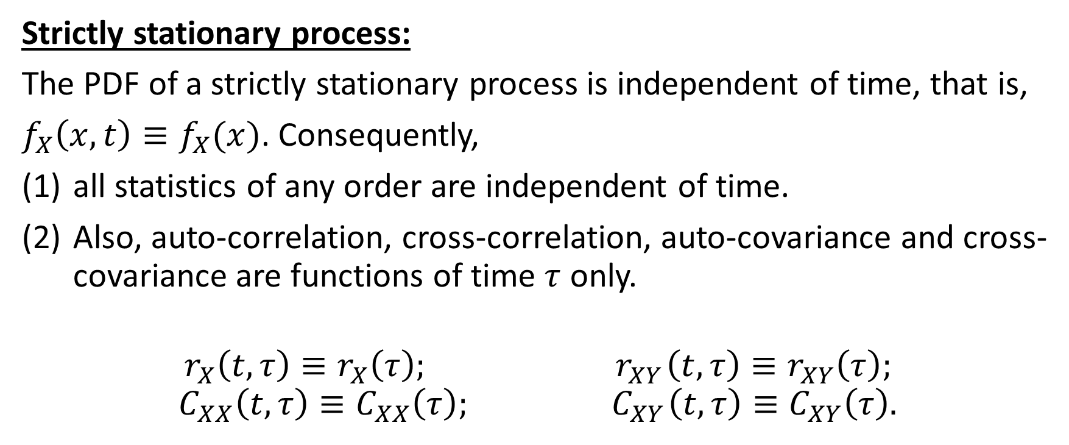
Non-stationary processes versus Stationary Processes
Strictly stationary process:
The PDF of a strictly stationary process is independent of time, that is,
$f_{X}\left(x,t\right)≡f_{X}(x)$. Consequently,
all statistics of any order are independent of time.
Also, auto-correlation, cross-correlation, auto-covariance and cross-covariance are functions of time $τ$ only.
$$r_{X}\left(t,τ\right)≡r_{X}\left(τ\right); { r}_{XY}\left(t,τ\right)≡r_{XY}\left(τ\right);$$
$$C_{XX}\left(t,τ\right)≡C_{XX}\left(τ\right); { C}_{XY}\left(t,τ\right)≡C_{XY}\left(τ\right).$$

Slide 9
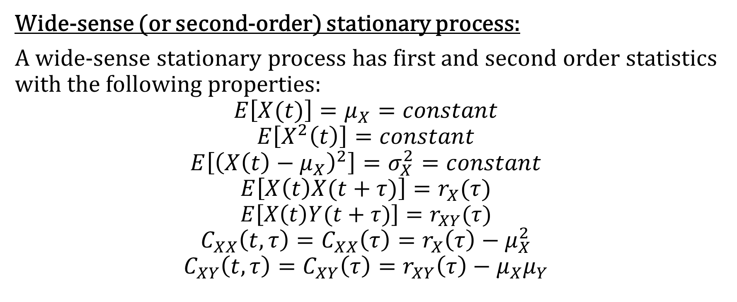
Wide-Sense Stationarity (WSS)
Wide-sense (or second-order) stationary process:
A wide-sense stationary process has first and second order statistics with the following properties:
$$E\left[X(t)\right]=μ_{X}=constant$$
$$E\left[X^{2}\left(t\right)\right]=constant$$
$$E\left[{\left(X\left(t\right)−μ_{X}\right)}^{2}\right]=σ_{X}^{2}=constant$$
$$E\left[X\left(t\right)X(t+τ)\right]=r_{X}(τ)$$
$$E\left[X\left(t\right)Y(t+τ)\right]=r_{XY}(τ)$$
$$C_{XX}\left(t,τ\right)=C_{XX}\left(τ\right)=r_{X}\left(τ\right)−μ_{X}^{2}$$
$$C_{XY}\left(t,τ\right)=C_{XY}\left(τ\right)=r_{XY}\left(τ\right)−μ_{X}μ_{Y}$$

Slide 10
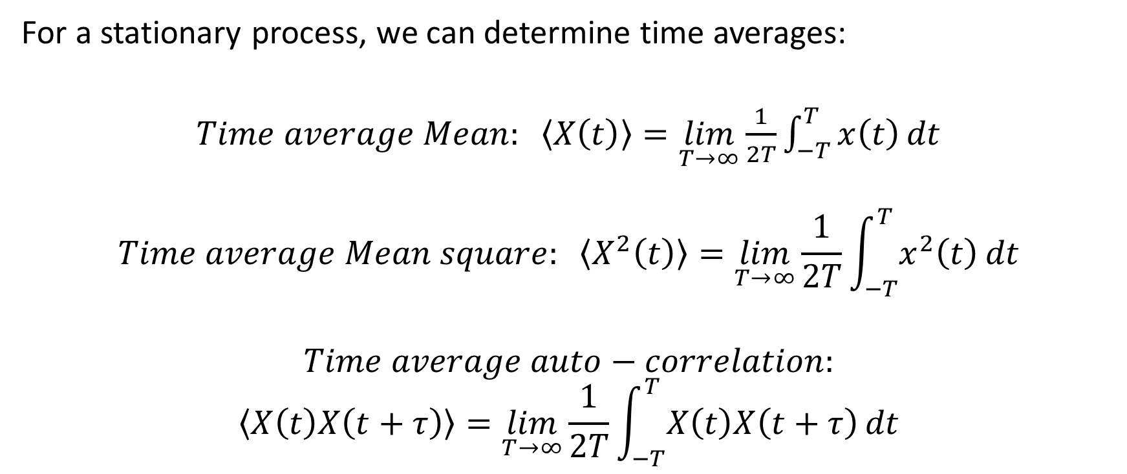
Time Averages
For a stationary process, we can determine time averages:
$Time average Mean: \left\langle X\left(t\right)\right\rangle =\lim_{T→∞}\frac{1}{2T}\int_{−T}^{T}{x\left(t\right)}dt$
$$Time average Mean square: \left\langle X^{2}\left(t\right)\right\rangle =\lim_{T→∞}\frac{1}{2T}\int_{−T}^{T}{x^{2}\left(t\right)}dt$$
$$Time average auto−correlation:$$
$$\left\langle X\left(t\right)X\left(t+τ\right)\right\rangle =\lim_{T→∞}\frac{1}{2T}\int_{−T}^{T}{X\left(t\right)X\left(t+τ\right)}dt$$

Slide 11
Ergodic Stochastic Process
In general, time averages and statistical averages are not equal.
Definition: A process is said to be ergodic if the time averages equal the statistical averages.
Most processes we encounter in electrical engineering are ergodic processes.

Slide 12
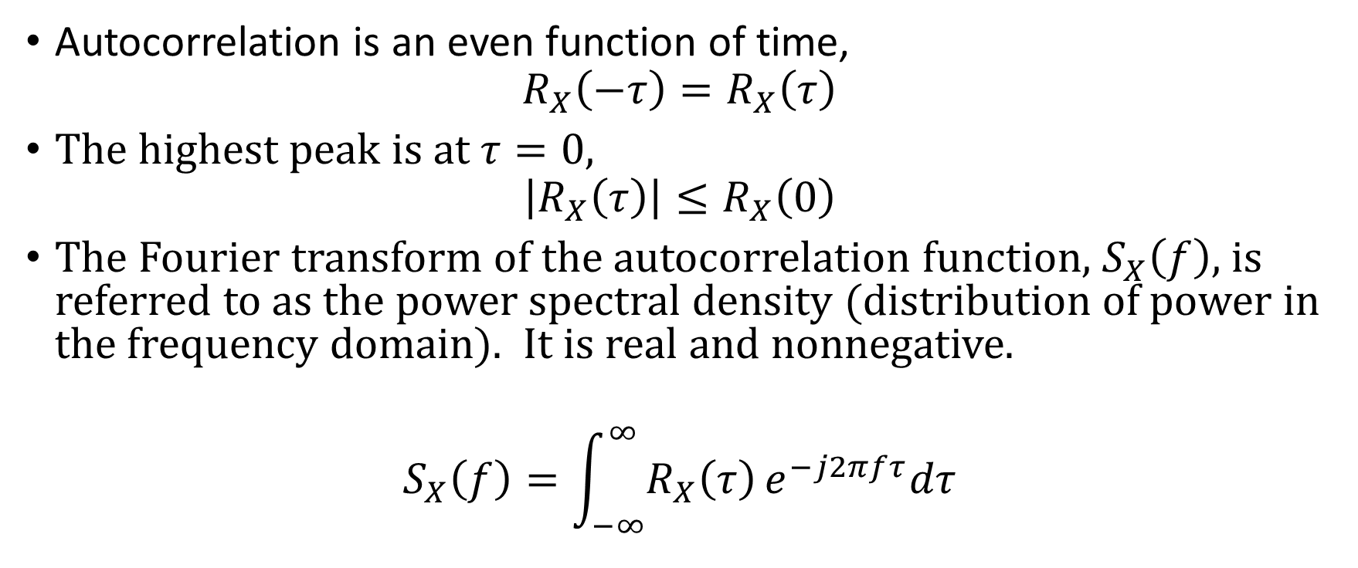
Properties of the Autocorrelation Function
Autocorrelation is an even function of time,
$$R_{X}\left(−τ\right)=R_{X}\left(τ\right)$$
The highest peak is at $τ=0,$
$$\left|R_{X}\left(τ\right)\right|≤R_{X}\left(0\right)$$
The Fourier transform of the autocorrelation function, $S_{X}\left(f\right)$, is referred to as the power spectral density (distribution of power in the frequency domain). It is real and nonnegative.
$$S_{X}\left(f\right)=\int_{−∞}^{∞}{R_{X}\left(τ\right)}e^{−j2πfτ}dτ$$

Slide 13

Properties of the Cross-Correlation Function
If $R_{XY}\left(τ\right)=0$, for all values of $τ,$ then $X and Y$ are uncorrelated.
(b) $R_{XY}\left(−τ\right)=R_{YX}\left(τ\right)$.

Slide 14
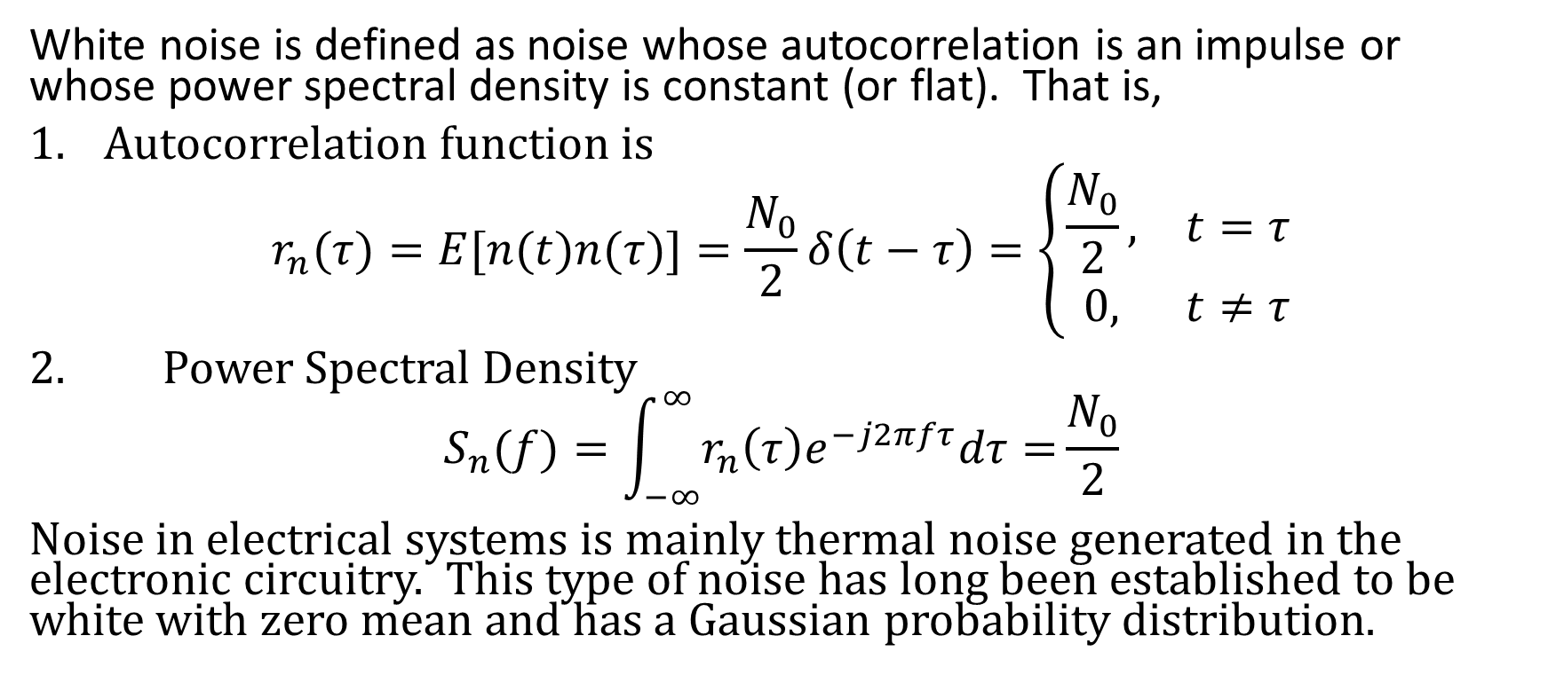
White Noise Process
White noise is defined as noise whose autocorrelation is an impulse or whose power spectral density is constant (or flat). That is,
Autocorrelation function is
$$r_{n}(τ)=E[n(t)n(τ)]=\frac{N_{0}}{2}δ\left(t−τ\right)=\left\{\begin{matrix}\frac{N_{0}}{2}, & t=τ \\ 0, & t≠τ\end{matrix}\right.$$
2. Power Spectral Density
$$S_{n}(f)=\int_{−∞}^{∞}{r_{n}\left(τ\right)e^{−j2πfτ}dτ=}\frac{N_{0}}{2}$$
Noise in electrical systems is mainly thermal noise generated in the electronic circuitry. This type of noise has long been established to be white with zero mean and has a Gaussian probability distribution.

Slide 15
Major Pioneers of Probability and Statistics

